Slide 1
Hospital Management System
Hamza Zahid 219400
Sami Alavi 209433
Fatima Binte Hyder 219322
Noor Ul Ayn 208971

Slide 2
Introduction

Slide 3
Introduction
Hospitals play a vital role in our healthy life
Main purpose:
Minimize the paperwork
Perform the tasks quickly
Web based and Android application
Improved the original Shifa application
User can be admin, doctor, patient or a pharmacist

Slide 4
Introduction
The admin has the main control over the system
The data of the patients and the doctors is maintained
Patients request appointments
Doctors check the appointments

Slide 5
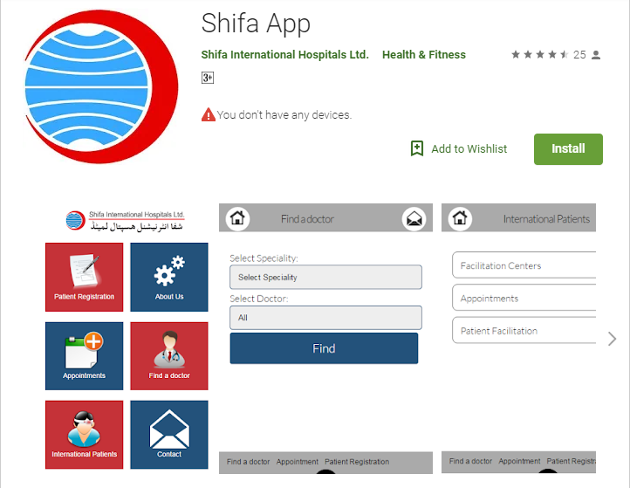

Slide 6
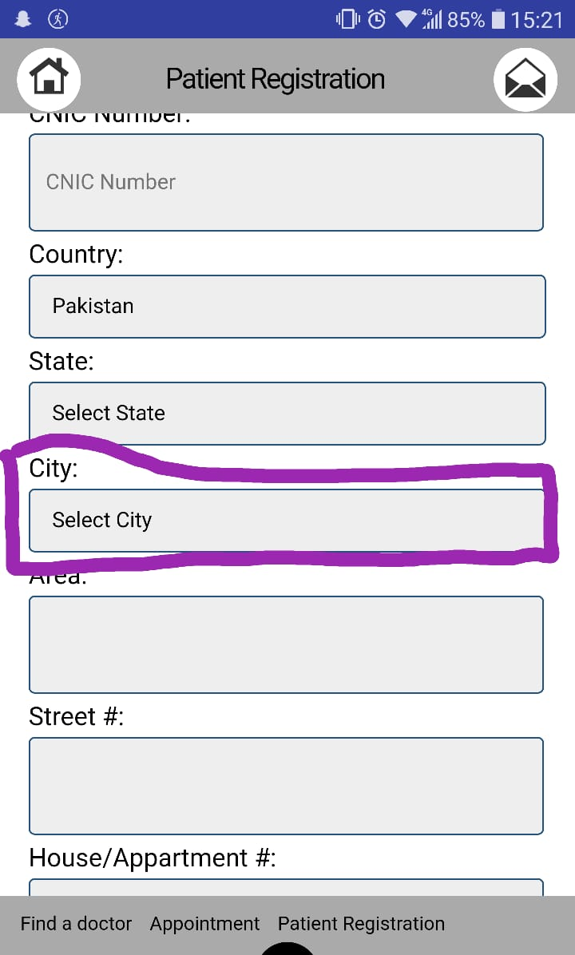
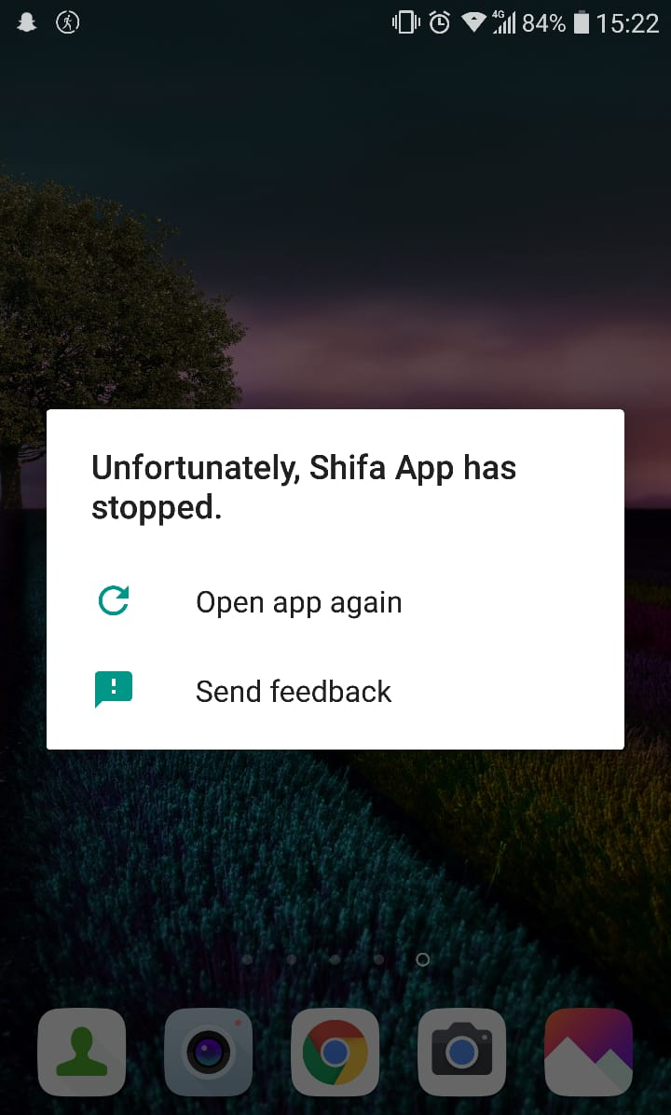

Slide 7


Slide 8





Technologies Used

Slide 9
Functions

Slide 10
Functions
The admin shall be able to perform these functions:
Register Doctors
Register pharmacists
View Doctors
View Patients
Remove Doctors
Remove pharmacists

Slide 11
Functions
The patient shall be able to perform the following functions:
Patient registration
Patient Log in
Make an appointment
Choose doctor
Check appointment status
View appointment history

Slide 12
Functions
The doctor shall be able to perform the mentioned functions:
Doctor Log in
View appointment requests
Accept / Decline / Delete appointments

Slide 13
Functions
The pharmacist will be able to perform the following:
Pharmacist log in
View medicines
Add medicines

Slide 14
Functional Requirements

Slide 15
Functional Requirements
Hardware interfaces
Wireless LAN
Ethernet
Android device
PC

Slide 16
Functional Requirements
Software Interfaces
Windows / Linux / Unix / Mac
TCP / IP Protocol
Android API >14
Minimum Google Services Version 4.0.2

Slide 17
Functional Requirements
Storage requirements
Apk size 6.15 MB
Cache size can vary

Slide 18
Non-Functional Requirements

Slide 19
Non-Functional Requirements
Security:
Uses google services to protect the database
Availability:
24/7

Slide 20
Non-Functional Requirements
Dependability:
The patient must be registered to see appointment status
The doctors/pharmacist can only be added by the admin
The doctor must log in to check the appointment
Pharmacist must be logged in to add the medicines

Slide 21
Diagrams

Slide 22
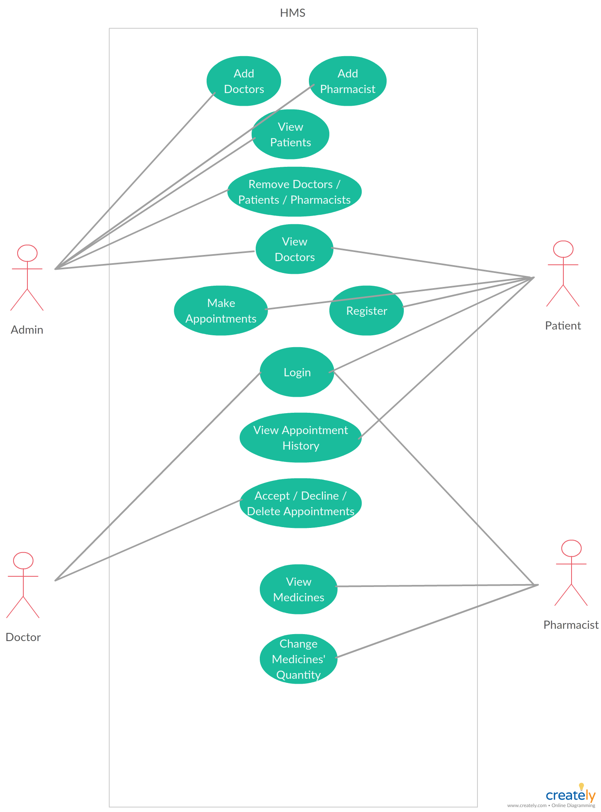
Use Case Diagram

Slide 23
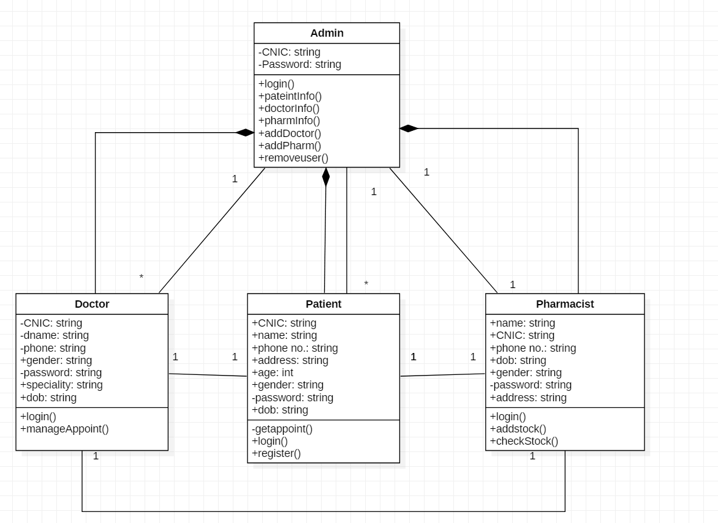
Class Diagram
*
*
*
*
*

Slide 24
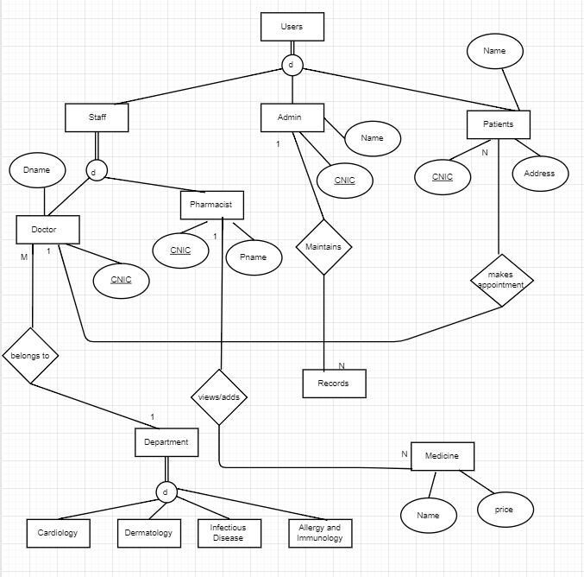
EER Diagram

Slide 25
Advantages

Slide 26
Advantages
Reduces manual labour
Works on almost every device
Easy Registration
Fast data access
Real time database
Fast status check
Appointment history
Responsive User Interfaces

Slide 27
The End

